Slide 1


Join at slido.com
#1904522
ⓘ
Click Present with Slido or install our Chrome extension to display joining instructions for participants while presenting.
Notes:
📣 This is Slido interaction slide, please don't delete it.
✅ Click on 'Present with Slido' and the joining instructions will appear when you get to this slide.

Slide 2
Exploratory Data Analysis (EDA) V
LECTURE 6
Key EDA concepts, DBMS and SQL
Data C100/Data C200, Fall 2026 @ UC Berkeley
Ramesh Sridharan and Jeremy Sanchez
Content credit: Acknowledgments

Slide 3
📣 Announcements
Starting with HW 2, all assignments will now be submitted on Pensive
You do not need to resubmit HW00 and HW1 to Pensive
HW 2 due Friday 9/18 on Pensive
Small-Group Tutoring Sign Ups are open! Tutoring sections begin this week.
Very helpful way to receive more 1-1 help and review content in a small group setting
Limited availability remaining; more info in the Ed announcement
Discussion swaps are locking this Friday
Exam reminders
Prerequisite quiz is done! Use your results to help you prepare for the semester.
Use the exam extenuating circumstances form for all exam-related emergencies.
For future exams, you may not receive makeup opportunities if you miss your exam slot (this includes duo authentication issues, etc.)!

Slide 4
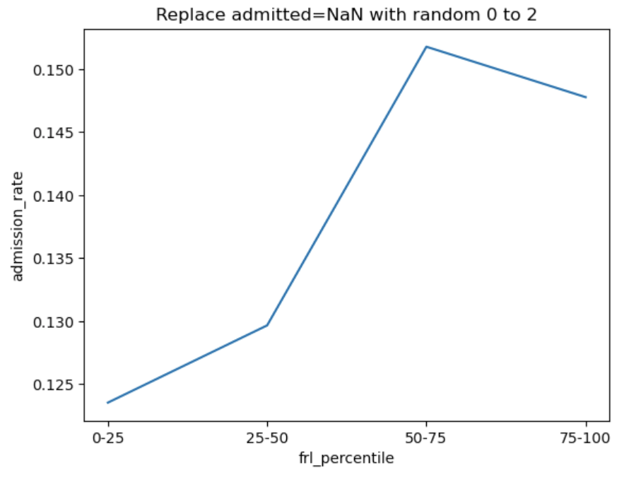
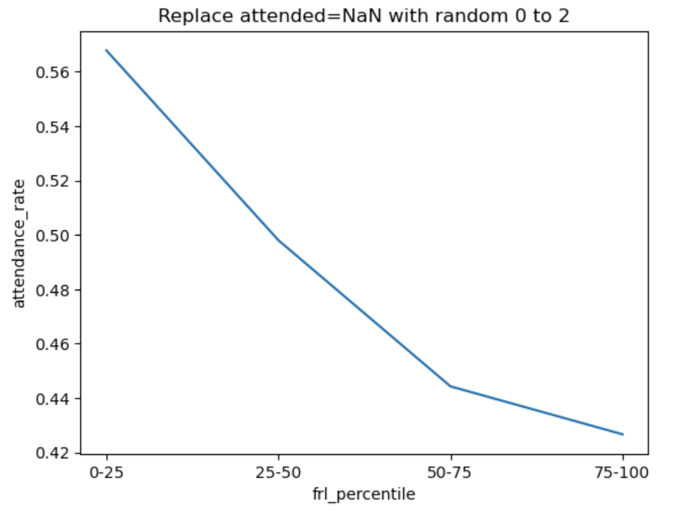
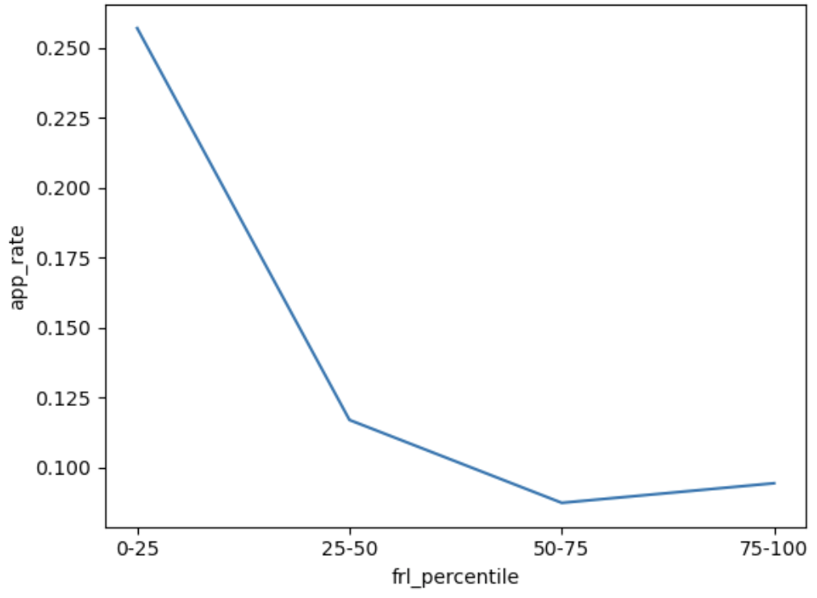
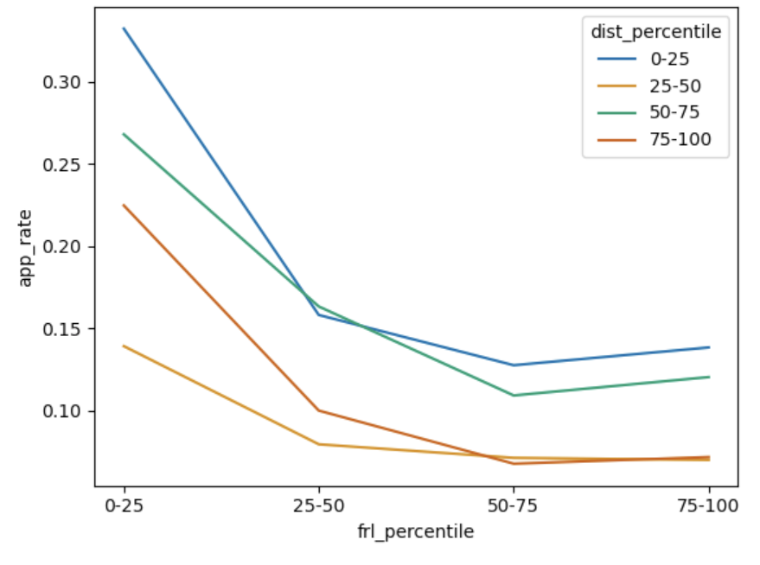
Recap: Cal Admissions

Slide 5
Recap: Variable Types
Variable
Quantitative
Qualitative
(categorical)
Measurable numerical values
Examples:
Price
Temperature
Age
Ordinal
Nominal
Ordered categories
Unordered categories
Examples:
Grade level
Age group
Examples:
Phone brand
Randomly assigned ID numbers
A safe default: Store qualitative data as strings!

Slide 6
(we'll come back to this!)
Structure -- the "shape" of a data file
Granularity -- how fine/coarse is each datum → a single "piece" of data
Temporality -- how is the data situated in time
Faithfulness -- how well does the data capture "reality"
Key Data Properties to Consider in EDA

Slide 7
An Important Conundrum in Data Science
Singular "data" | "The data shows …"
Plural "data" (datums) | "The data show …"
The first one is technically incorrect, but in practice, either is fine 🙂

Slide 8
Granularity: How Fine/Coarse Is Each Datum?
Row 1
Row 1
Row 2
Row 3
Row 1
Row 2
Row 3
Fine
Grained
Coarse
Grained
What does each record (row) represent?
Examples: a single purchase, a single person, a group of users
Some data will include summaries (aka rollups) as records.
If the data are coarse, how were the records aggregated?
Summing, averaging, or something else?

Slide 9



Do not edit
How to change the design
What does each row of the `elections` dataset represent? In other words, what is granularity of `elections`?
Presenting with animations, GIFs or speaker notes? Enable our Chrome extension
Notes:
📣 This is Slido interaction slide, please don't delete it.
✅ Click on 'Present with Slido' and the poll will launch automatically when you get to this slide.

Slide 10
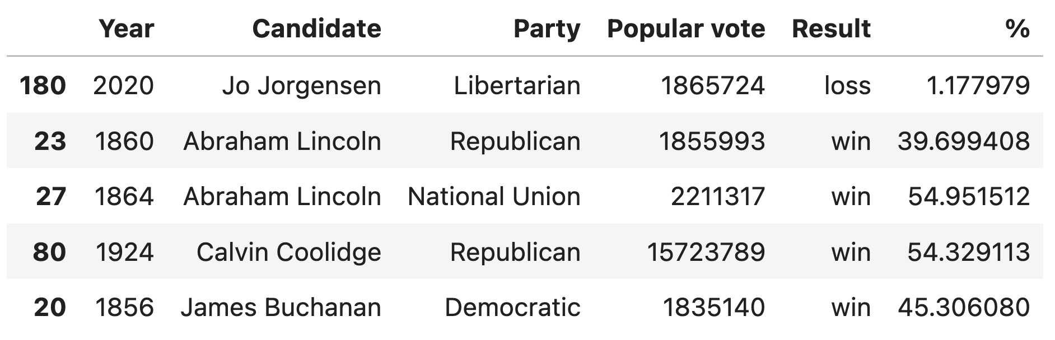
Granularity of elections
Each row of elections represents a unique combination of candidate and year.
Assumptions: One election per year and candidate represents one party per election.

Slide 11
Do not edit
How to change the design
What is the granularity of the `babynames` dataset?
Presenting with animations, GIFs or speaker notes? Enable our Chrome extension
Notes:
📣 This is Slido interaction slide, please don't delete it.
✅ Click on 'Present with Slido' and the poll will launch automatically when you get to this slide.

Slide 12
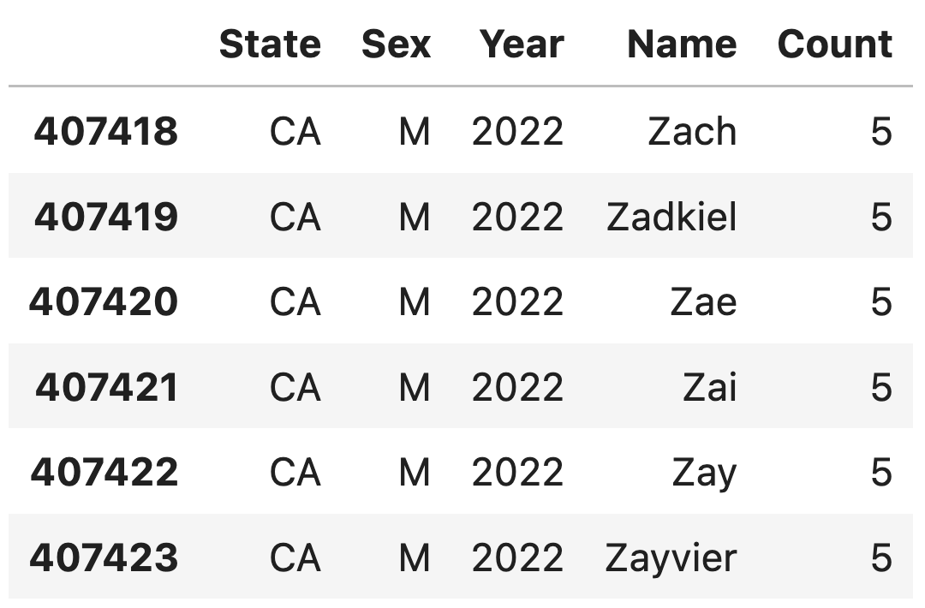
Granularity of babynames
Each row of babynames represents a unique combination of name, state, sex, and year.

Slide 13
Structure -- the "shape" of a data file
Granularity -- how fine/coarse is each datum
Temporality -- how is the data situated in time
Faithfulness -- how well does the data capture "reality"
Key Data Properties to Consider in EDA

Slide 14


What type of variable is a datetime (e.g., 01/01/2025 3:30pm)?
ⓘ
Click Present with Slido or install our Chrome extension to activate this poll while presenting.
Notes:
📣 This is Slido interaction slide, please don't delete it.
✅ Click on 'Present with Slido' and the poll will launch automatically when you get to this slide.

Slide 15
How Should We Store Datetimes?
As humans, we write datetimes as strings: 01/01/2025 3:30pm
First try: store as a categorical string, e.g. "010120250330p"
  Problem: difficult to make comparisons (before/after), do computation (how long between), etc.
  Problem: wastes space. Strings require more bits than numbers.
Better idea: store as numerical values
Computing standard: Unix/POSIX time
  Number of seconds* since January 1st 1970 UTC (Coordinated Universal Time)
    Example: Feb 4, 2025 5:00pm PDT → 1738674000 (1,738,674,000 seconds)
    Example: Feb 4, 1950 5:00pm PDT → -628167600 (-628,167,600 seconds)
  Easy to make comparisons, calculate “time between X and Y,” etc.

Slide 16
Variable Type
Multiple Files
File Format
Structure -- the "shape" of a data file
Granularity -- how fine/coarse is each datum
Temporality -- how is the data situated in time
Faithfulness -- how well does the data capture "reality"
Key Data Properties to Consider in EDA

Slide 17
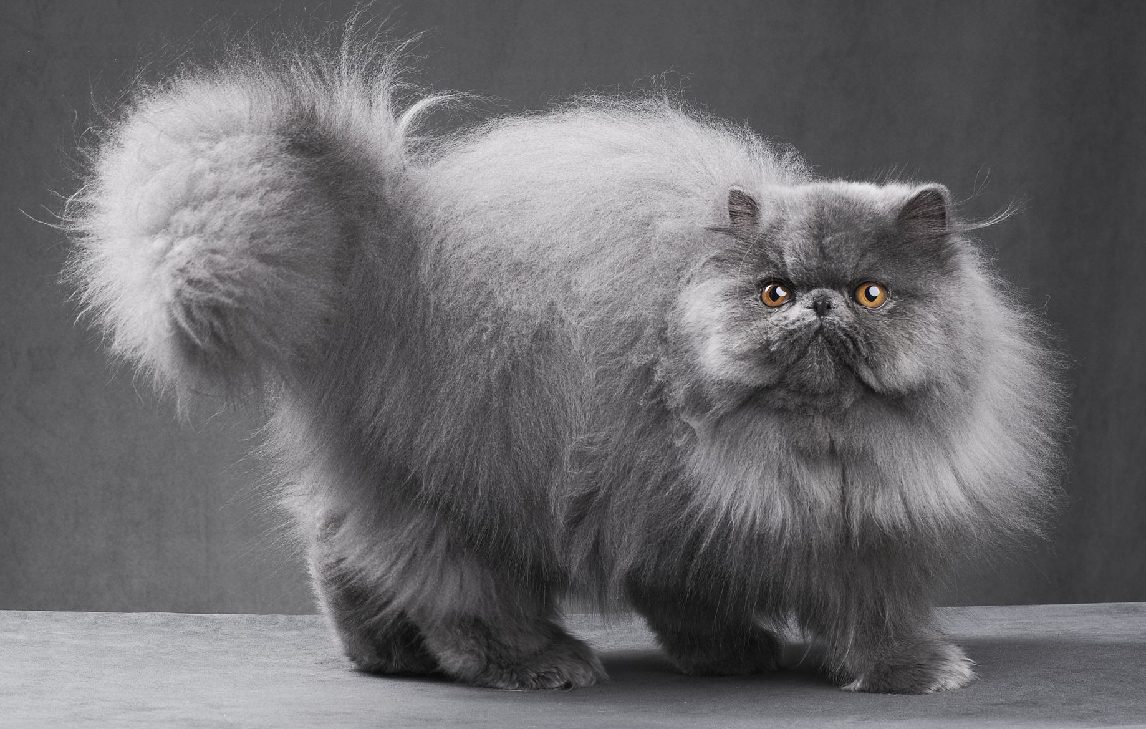
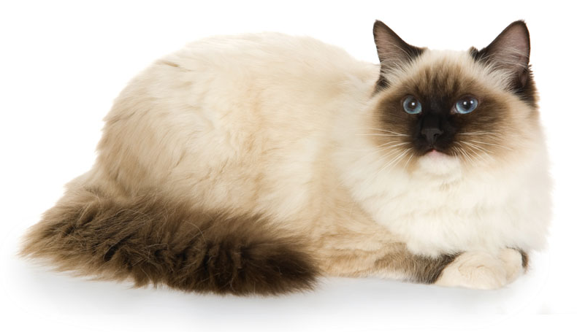
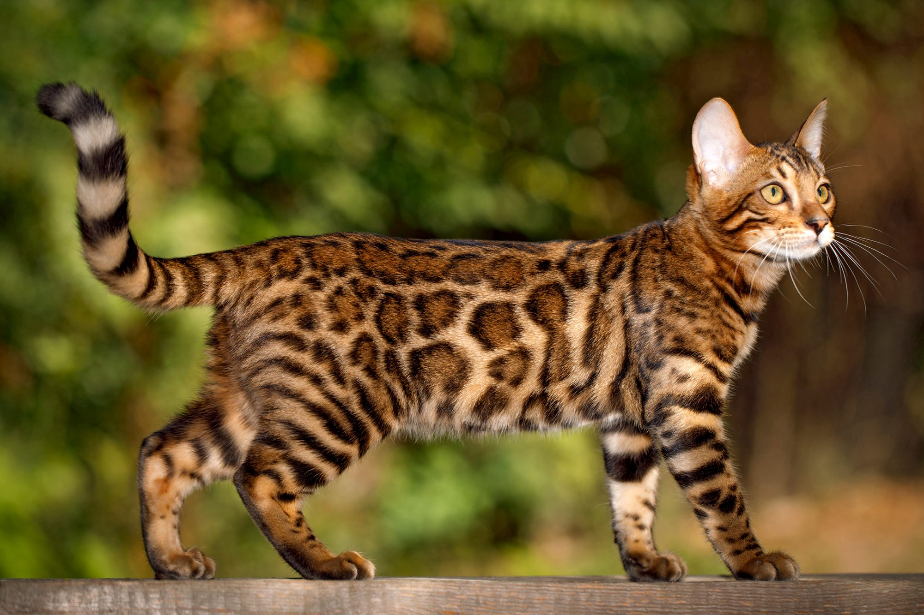
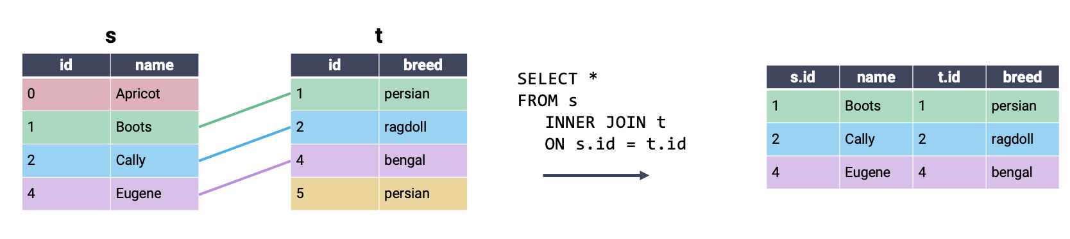
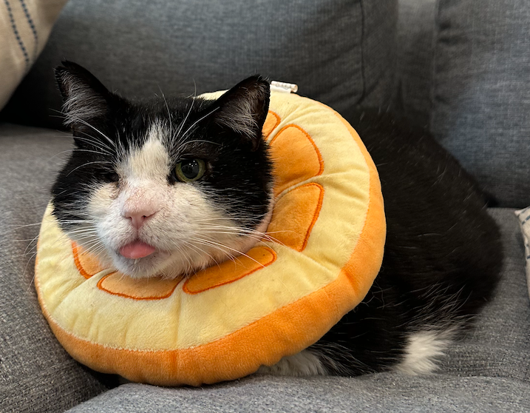
Tables About Cats
Persian
Ragdoll
Bengal
Helios*

Slide 18
Inner Join
Inner join: Combine every row from the first table with its matching entry in the second table. If a row does not have a match, it is omitted.

Slide 19
Inner Join
Inner join: Combine every row from the first table with its matching entry in the second table. If a row does not have a match, it is omitted.

Slide 20
JOIN Syntax
Specify joins between tables as part of the FROM statement
Desired type of join
SELECT *
FROM table1 INNER JOIN table2
ON table1.key = table2.key
What columns to use to determine matching entries
table1.join(table2, on=key, how='inner')

Slide 21
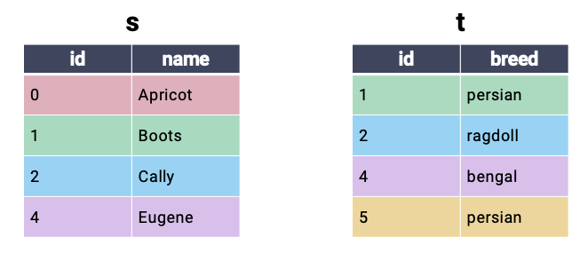
Cross Join
Cross join: Every combination of possible rows. Also called a cartesian product.

Slide 22
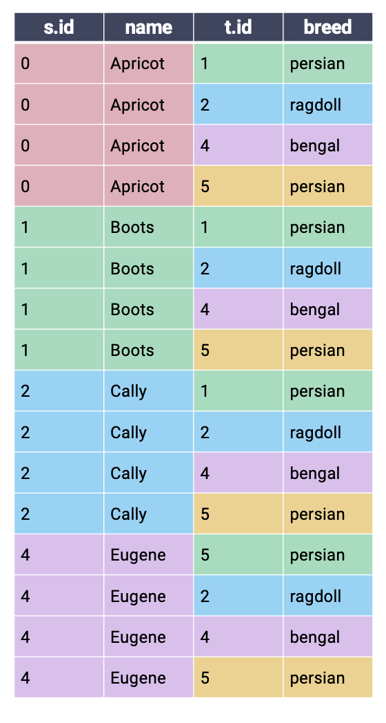
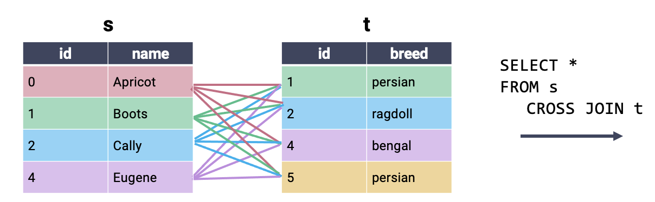
Cross Join
Cross join: Every combination of possible rows. Also called a cartesian product.
Notice that there is no need to specify a matching key (i.e., the columns to use for merging)

Slide 23
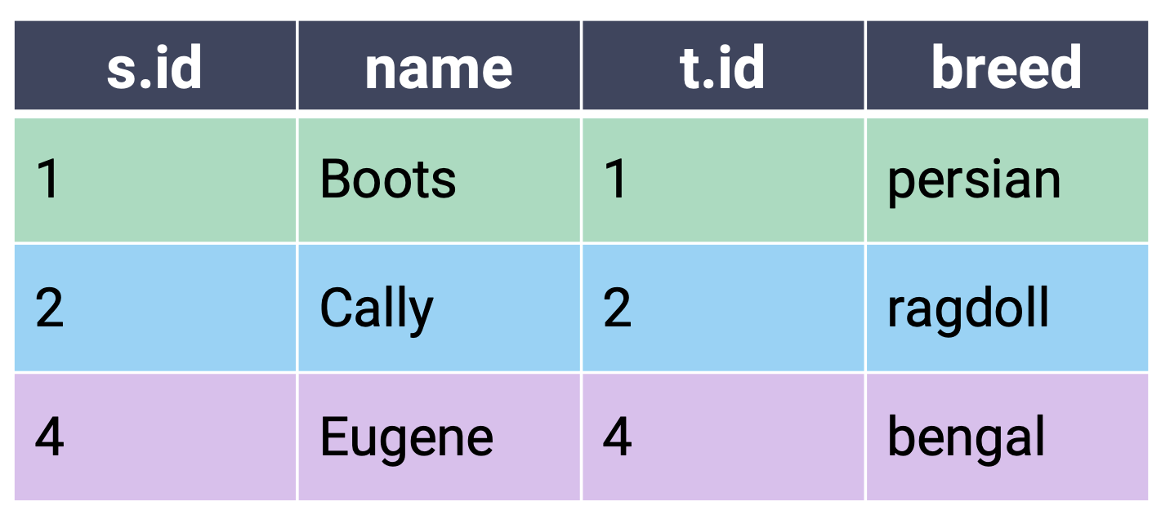
Inner Join: Cross Join With Filtering
Conceptually, you can imagine an inner join as a cross join filtered to include only matching rows.
SELECT *
FROM s CROSS JOIN t
WHERE s.id = t.id;
Equivalent
SELECT *
FROM s INNER JOIN t
ON s.id = t.id;

Slide 24
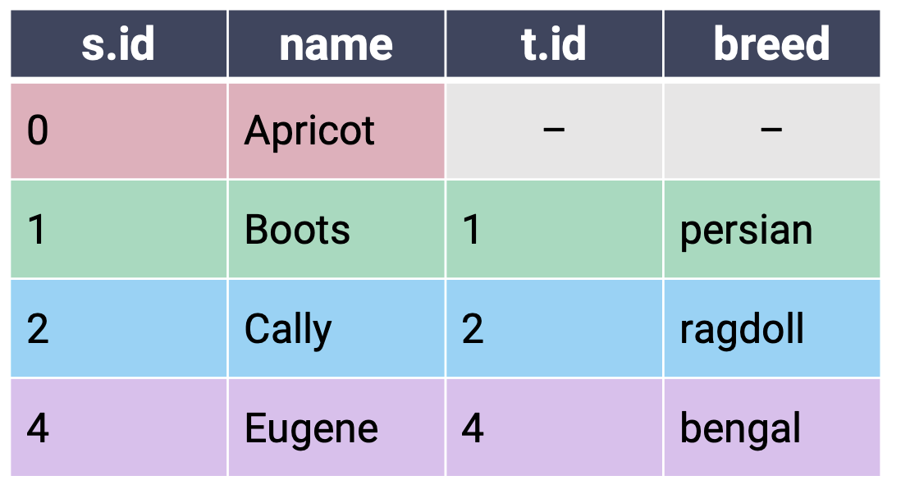
Left Outer Join
In a left outer join (or just left join), keep all rows from the left table and only matching rows from the right table. Fill NULL for any missing values.
SELECT *
FROM s LEFT JOIN t
ON s.id = t.id;
Fill values without matching entries in the right table with NULL
The “left table” is whichever table is referenced first in the JOIN statement.

Slide 25
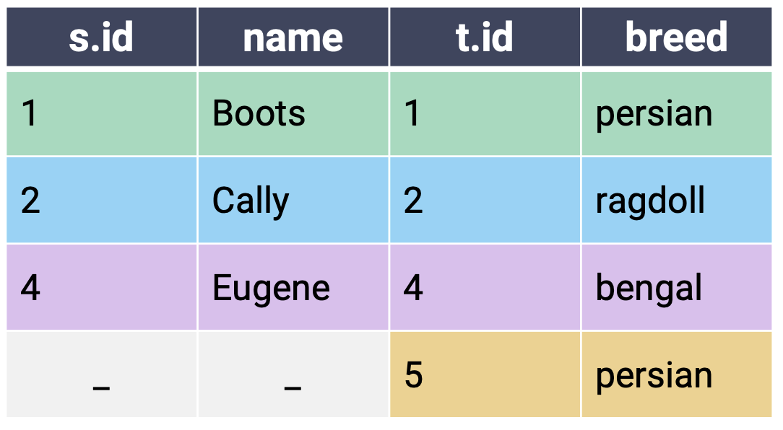
Right Outer Join
In a right outer join (or just right join), keep all rows from the right table and only matching rows from the left table. Fill NULL for any missing values.
SELECT *
FROM s RIGHT JOIN t
ON s.id = t.id;
The “right table” is whichever table is referenced second in the JOIN statement.

Slide 26
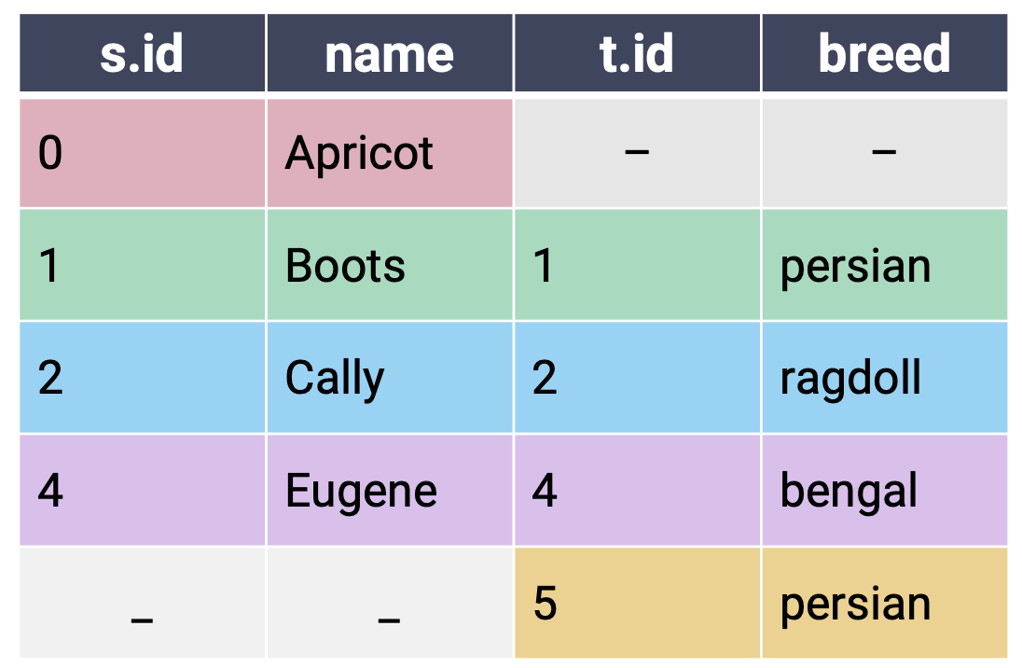
Full Outer Join
In a full outer join, keep all rows from both the left and right tables. Pair any matching rows, then fill missing values with NULL. Conceptually similar to performing both left and right joins.
SELECT *
FROM s FULL JOIN t
ON s.id = t.id;

Slide 27
Do not edit
How to change the design
Which of the following returns the same information as the SQL query at the top? Note: Column order does not matter.
Presenting with animations, GIFs or speaker notes? Enable our Chrome extension
Notes:
📣 This is Slido interaction slide, please don't delete it.
✅ Click on 'Present with Slido' and the poll will launch automatically when you get to this slide.

Slide 28
Equivalent Joins Slido
SELECT *
FROM s LEFT JOIN t
ON s.id = t.id;
SELECT *
FROM s LEFT JOIN t
ON t.id = s.id;
A
✅ Equality order does not matter.
SELECT *
FROM t RIGHT JOIN s
ON s.id = t.id;
B
✅ A right join is just a left join with the table order reversed. t.id and breed will now be the first two columns.
SELECT *
FROM s FULL JOIN t
ON s.id = t.id
WHERE s.id IS NOT NULL;
C
✅

Slide 29
Variable Type
Multiple Files
File Format
Structure -- the "shape" of a data file
Granularity -- how fine/coarse is each datum
Temporality -- how is the data situated in time
Faithfulness -- how well does the data capture "reality"
Key Data Properties to Consider in EDA

Slide 30
CSV: Comma-Separated Values
Flu data from CDC (source)
CSV is a very common tabular file format.
Records (rows) are delimited by a newline: '\n'
Fields (columns) are delimited by commas: ','
Pandas: pd.read_csv(header=...)
Fields/Attributes/Features/Columns
 | U.S. jurisdiction | TB cases 2019 | …
0 | Total | 8,900 | …
1 | Alabama | 87 | …
Records/Rows

Slide 31
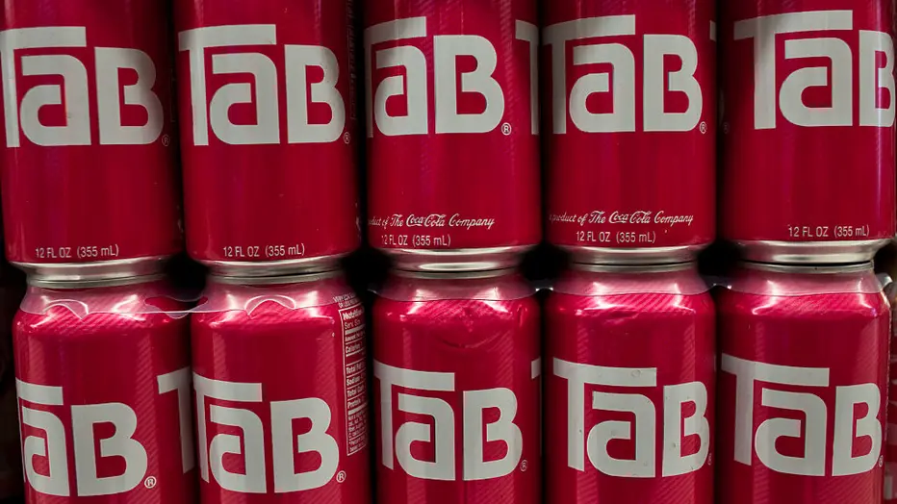
TSV: Tab Separated Values
Another common table file format.
Fields are delimited by '\t' (tab)
Like a CSV with tabs instead of commas
pd.read_csv: Need to specify
delimiter='\t'
TaB soda: Precursor to Diet Coke

Slide 32
JSON: JavaScript Object Notation
CA Senators+Reps data (congress.gov API)
Very similar to Python dictionaries
Self-documenting: Metadata (data about the data) + records in the same file
pd.read_json()
pd.DataFrame(json_dict)
JSON is non-rectangular, so good to inspect the file before importing.
Nested tables
Inconsistent fields across records

Slide 33
Structure -- the "shape" of a data file
Granularity -- how fine/coarse is each datum
Temporality -- how is the data situated in time
Faithfulness -- how well does the data capture "reality"
Key Data Properties to Consider in EDA

Slide 34
Faithfulness: Do I trust this data?
Key Questions: How well does our data reflect reality? Are there discrepancies between what the data says and reality?
Some questions to help with the answers:
  Are there any biases in the data collection process?
  Who (or what) might not be represented in this data?
  Would the data look different if it were collected by someone else?
  Why is the data grouped/sliced the way it is?
  Were there relevant limitations in the data-gathering process?

Slide 35
What are some potential issues with this dataset? You can answer more than once.
ⓘ
Click Present with Slido or install our Chrome extension to activate this poll while presenting.
Notes:
📣 This is Slido interaction slide, please don't delete it.
✅ Click on 'Present with Slido' and the poll will launch automatically when you get to this slide.

Slide 36
What are Some Potential Issues with this Dataset?
ID | Category | State | Location | Device | Purchased | …
0 | Shoes | CA | CA | 1 | 1 | …
1 | Socks | NM | NM | 1 | 0 | …
2 | Socks | XY | XY | 1 | 0 | …
3 | Shirts | NY | NY | 1 | NA | …
4 | Shoes | FL | FL | 1 | 0 | …
4 | Shoes | FL | FL | 1 | 0 | …
5 | Shirts | CA | CA | 1 | 0 | …
6 | Pnts | TX | TX | 1 | 1 | …
7 | Hats | CA | CA | 1 | -1 | …
… | … | … | … | … | … | …

Slide 37
Faithfulness: Do I trust this data?
Fully Duplicated Records or Fields
Ignore/drop, if no reason for duplication.
Labeling or Spelling Errors
Apply corrections. Only ignore if you have to.
Missing data
Need to think carefully about why the data is missing.
Examples
" "
0, -1
999, 12345
1970, 2000
NaN
Null
NaN: "Not a Number"
Real zero or NaN placeholder? Sometimes both!
See footnote 12 in onlinelibrary.wiley.com/doi/abs/10.1111/jels.12343

Slide 38
Missing Data: Approaches
A. Keep as NaN
A good default.
If qualitative/categorical → Consider creating a "Missing" category.
B. Drop records with missing values
Typically a bad default!
Temperature probe went offline for a minute → Likely missing at random → OK to drop
Police officer never records outcomes of vehicle stops → Likely not missing at random
C. Imputation/Interpolation: Infer missing values
Mean/median imputation: replace NaN with mean/median
Hot deck imputation: use a random non-NaN value
Regression imputation: use a model to predict value
Multiple imputation: multiple random values + check sensitivity
(beyond this course)

Slide 39
Agenda
Key Data Properties
  Structure
  Granularity
  Temporality
  Faithfulness
Databases: Why SQL?

Slide 40

Brief Databases Overview
A database is an organized collection of data.
A Database Management System (DBMS) is a software system that stores, manages, and facilitates access to one or more databases.
Common Large-Scale DBMS Systems used in Data Science:
Google BigQuery
Amazon Redshift
Snowflake
Databricks
Microsoft SQL Server
…

Slide 41
Advantages of DBMS over Raw Files (e.g., CSV)
Data Storage:
Reliable storage to survive system crashes and disk failures.
Optimize to compute on data that does not fit in memory.
Special data structures to improve performance (see CS (W)186).
Data Management:
Configure how data is logically organized and who has access.
Can enforce guarantees on the data (e.g., non-negative age of person).
  Can be used to prevent data anomalies.
  Ensures safe concurrent operations on data (multiple users reading and writing simultaneously, e.g., ATM transactions).

Slide 42
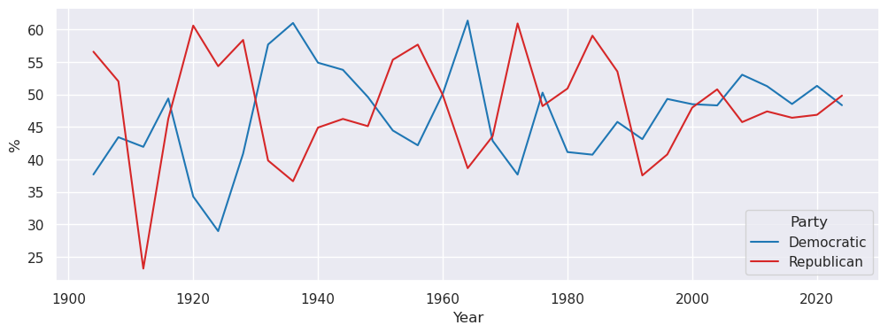
Review: A “typical” exploratory data analysis (EDA) workflow
A few snapshotted tables (or just one!)
Database with many dynamic tables
Basic table manipulations with SQL
Visualize with seaborn
(or R, matplotlib, Excel…)
Manipulate with polars
(or R, pandas, Excel…)
Dynamic: Updated frequently (e.g., after a customer purchase)
Snapshot: Version at some specific moment in time.

Slide 43
How do Data Scientists Use SQL?
Use SQL to get a CSV for pandas analysis
  Write a SQL query to get the initial dataset you need for your analysis
  Save the dataset as CSV (or JSON, etc.)
  Use pandas to explore and analyze the data
Interact directly with a DBMS using SQL
  Write SQL queries to explore and analyze your data
  Save final results to CSV
  Generate figures and summary info (using pandas or other tools)
Use an ORM (object relational mapping) to write Python code that gets automatically translated into SQL
  Most often used in large-scale software systems: not as common in data science
Write SQL queries that automatically run periodically (semi-automated version of (2))
…and many more!

Slide 44
SQL Terminology
Column or Attribute or Field
name TEXT, PK | year INT, >=1900 | cute INT | setting_id INT, FK
toothless | 2010 | 10 | 0
drogon | 2011 | -100 | 1
dragon 2 | 2019 | 0 | 2
Type TEXT, PK | Legs INT, >=0 | Weight INT, >=0
Corgi | 4 | 10
T-Rex | 2 | 12000
Penguin | 2 | 10
Row or Record or Tuple
Dragon
Relation (table) name
SQL tables are also called relations.
Every column has three properties: ColName, Type, and zero or more Constraints.
(Contrast with polars: Series have names and types, but no constraints.)

Slide 45
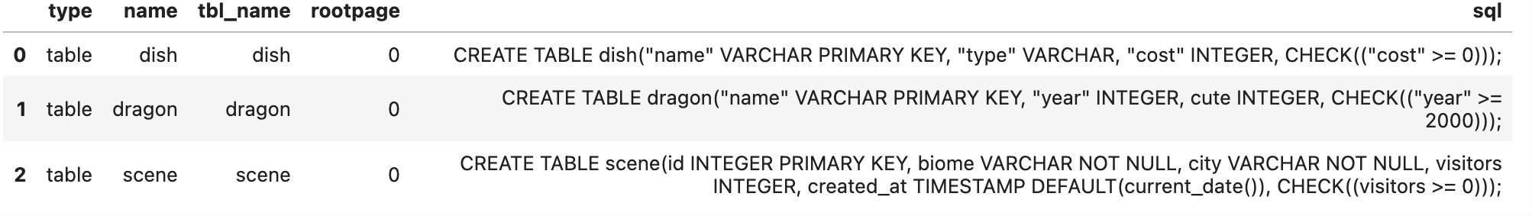
Table Schema
A schema describes the logical structure of a table. Whenever a new table is created, the creator must declare its schema.
For each column, specify the:
Column name
Data type
Constraint(s) on values
CREATE TABLE dragon (
name VARCHAR PRIMARY KEY,
yr INTEGER CHECK (yr >= 1900),
cute INTEGER,
setting_id INTEGER,
FOREIGN KEY (setting_id) REFERENCES setting(id)
);

Slide 46
Why do We Need Multiple Tables in a Database?
Suppose we want to add a column describing the setting that each dragon comes from.
name TEXT, PK | year INT, >=2000 | cute INT
toothless | 2010 | 10
drogon | 2011 | -100
dragon 2 | 2019 | 0
rhaegal | 2011 | -80

Slide 47
Why do We Need Multiple Tables in a Database?
Suppose we want to add a column describing the setting that each dragon comes from.
name TEXT, PK | year INT, >=2000 | cute INT | place TEXT
toothless | 2010 | 10 | Berk
drogon | 2011 | -100 | Essos
dragon 2 | 2019 | 0 | ISS
rhaegal | 2011 | -80 | Essos

Slide 48
Why do We Need Multiple Tables in a Database?
Suppose we want to add a column describing the setting that each dragon comes from.
name TEXT, PK | year INT, >=2000 | cute INT | place TEXT | source TEXT
toothless | 2010 | 10 | Berk | How to Train Your Dragon
drogon | 2011 | -100 | Essos | Game of Thrones
dragon 2 | 2019 | 0 | ISS | IRL
rhaegal | 2011 | -80 | Essos | Game of Thrones
As we add more columns, we start to run into problems:
Redundant information: every time we have multiple dragons from the same setting, all their information is duplicated!
Column bloat: at some point, this table isn’t really about Dragons anymore
Solution: split the information into multiple tables!

Slide 49
Using Multiple Tables to Store Information
We can add a new table with settings (locations, fictional or otherwise)
Dragon
Setting
name TEXT, PK | year INT, >=2000 | cute INT
toothless | 2010 | 10
drogon | 2011 | -100
dragon 2 | 2019 | 0
rhaegal | 2011 | -80
id INT, PK | place TEXT | source INT | mediatype TEXT
0 | Berk | How to Train Your Dragon | movie
1 | Essos | Game of Thrones | tv show
2 | International Space Station | IRL | None
3 | Lonely Mountain | The Hobbit | book
How do we tell SQL which setting each dragon comes from?

Slide 50
Using Multiple Tables to Store Information
We can add a new table with settings (locations, fictional or otherwise)
Dragon
Setting
name TEXT, PK | year INT, >=2000 | cute INT | setting_id INT, FK
toothless | 2010 | 10 | 0
drogon | 2011 | -100 | 1
dragon 2 | 2019 | 0 | 2
rhaegal | 2011 | -80 | 1
id INT, PK | place TEXT | source INT | mediatype TEXT
0 | Berk | How to Train Your Dragon | movie
1 | Essos | Game of Thrones | tv show
2 | International Space Station | IRL | NULL
3 | Lonely Mountain | The Hobbit | book
A foreign key refers to the primary key of another table, and tells us about the relationships between different tables.
These are usually what we use when JOINing tables together!

Slide 51
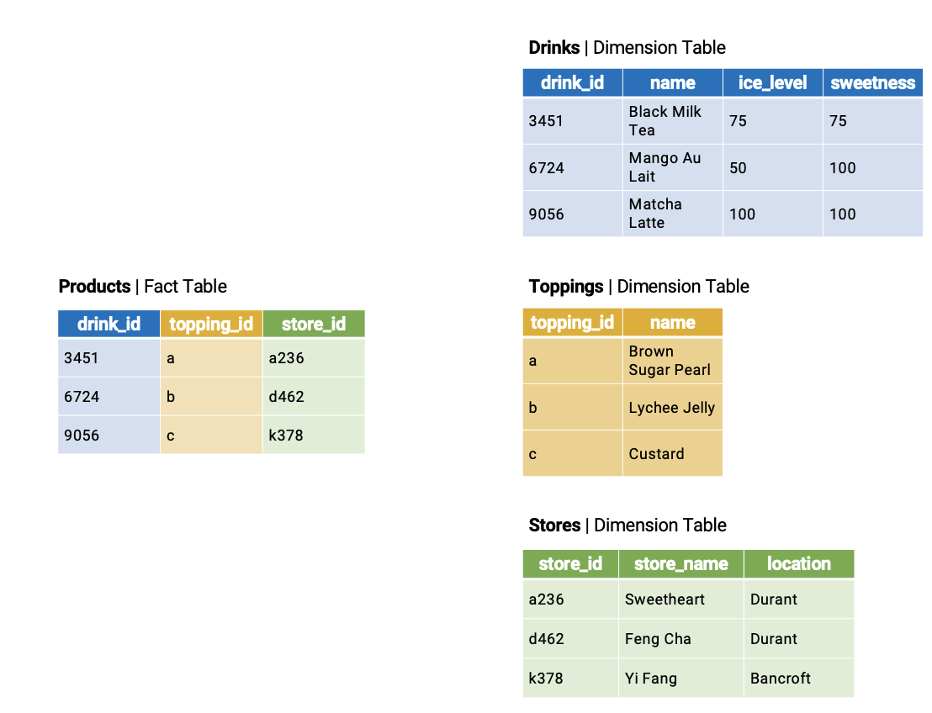
Multidimensional Data
To minimize redundant storage, databases store data across fact and dimension tables.
This is called a star schema.
Fact table: Central table w/ info to link its entries to other dimension tables. Few columns, many records.
Dimension table: More detailed information about each type of fact. More columns and fewer records.
. . .
. . .
. . .
Granularity: Every possible drink+topping combinations across all stores. Lots of rows!

Slide 52
Exploratory Data Analysis (EDA) V
LECTURE 6
Data C100/Data C200, Fall @ UC Berkeley
Ramesh Sridharan and Jeremy Sanchez
Content credit: Acknowledgments

